Slide 1


Slide 2
What Is Campus Compass?
A review system made by students for students
Accessible to both undergraduate to postgraduate students
An interactive map of the UoM campus
Helps new students orientate the campus and meet people
Allows existing students to discover new places.
Y18 | COMP10120 – First Year Team Project
2/21

Slide 3
Overview
Motivation – Why We Chose This Idea?
How Our Application Will Be Built?
Mock-up Designs
Security Features
Ethical Considerations
Team Organisation
Conclusion
Y18 | COMP10120 – First Year Team Project
3/21

Slide 4
Motivation - Why We Chose This Idea?
Absence of an existing system like the one we have designed
Personal experience of the struggles faced by students
Our application compiles all the knowledge and tips needed for students provided by students themselves.
Y18 | COMP10120 – First Year Team Project
4/21

Slide 5
Overview
Motivation – Why We Chose This Idea?
How Our Application Will Be Built?
Mock-up Designs
Security Features
Ethical Considerations
Team Organisation
Conclusion
Y18 | COMP10120 – First Year Team Project
5/21

Slide 6
How Our Application Will Be Built?
Account For Users
Review System
Interactive Map
Account Settings
Homepage
About Campus Compass
Contact Us
Log In
Sign Up
Account For Admin
Flagged Reviews
Search/Restrict Users
Add New Locations.
Y18 | COMP10120 – First Year Team Project
6/21

Slide 7
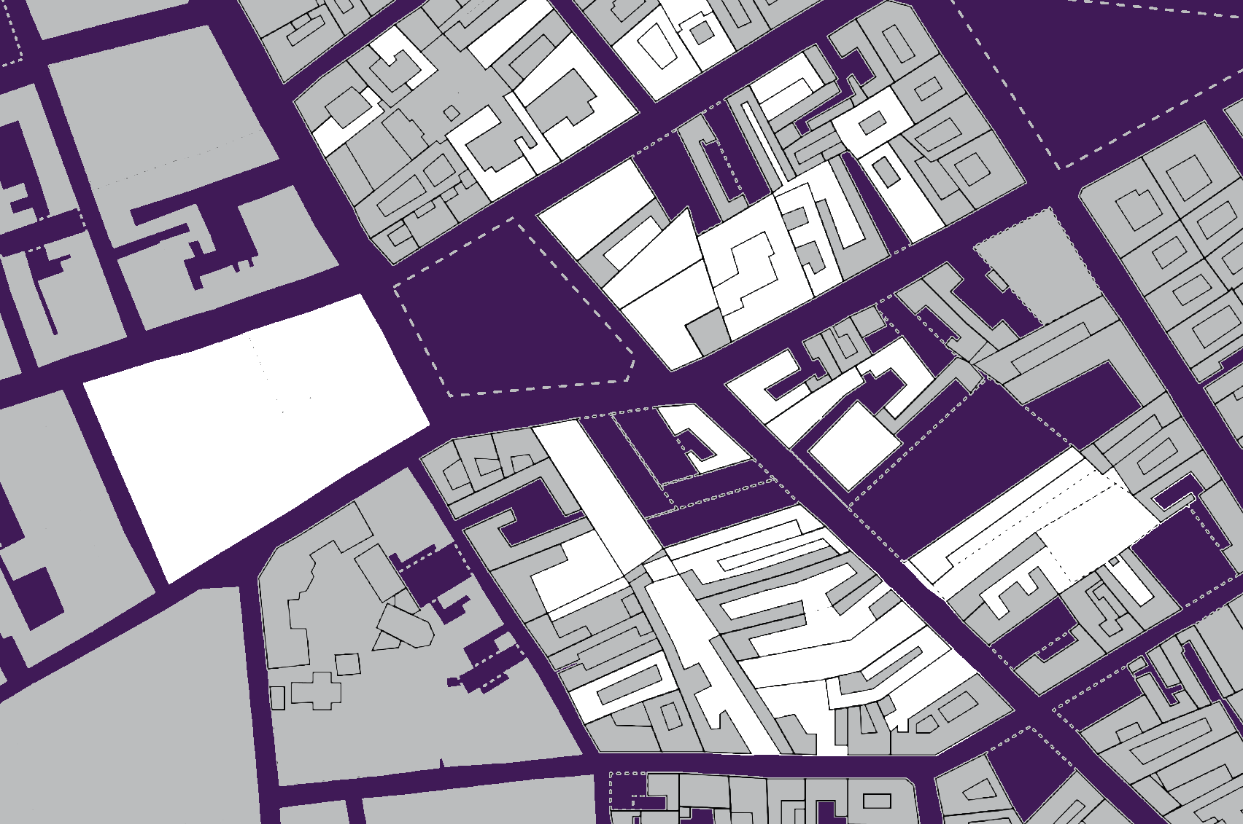
Interactive Map
Constructed using API
Click specific buildings on the campus
Access the location details
Read and publish reviews
See how crowded it is in real-time.
Y18 | COMP10120 – First Year Team Project
7/21

Slide 8
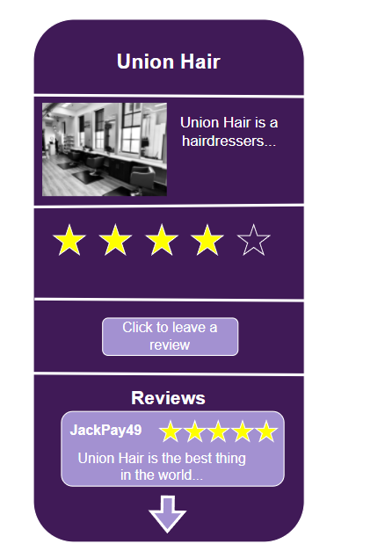
Review System
Divided into 2 halves
Create your own reviews
Read previous reviews
Filter system to read reviews based on star rating
Sorts locations by rating or most reviews
Students can flag inappropriate reviews.
Y18 | COMP10120 – First Year Team Project
8/21

Slide 9
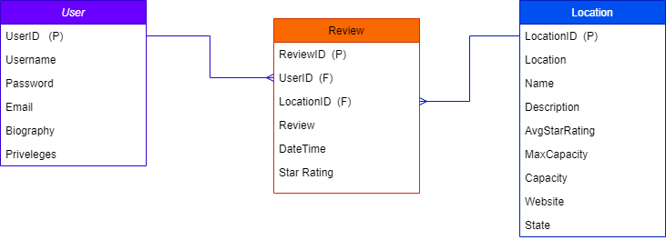
Back-End Database
Y18 | COMP10120 – First Year Team Project
9/21

Slide 10
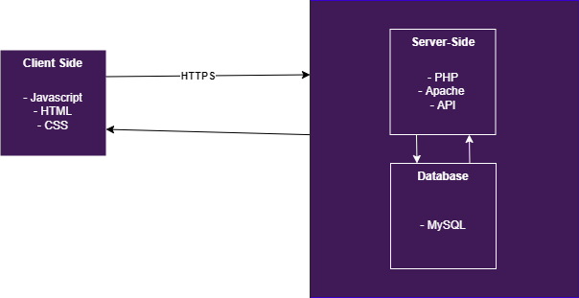
System Design
Why We Chose These Languages?
HTML, CSS – Simple, basic and fundamental of any web application
JavaScript – To include features and make web pages interactive
PHP – Well known language, easy to integrate in websites
MySQL – Group experienced from A-Level and it’s a well known database system
Python Versus PHP?
1. Not much knowledge or experience in python frameworks e.g. Django.
Y18 | COMP10120 – First Year Team Project
10/21

Slide 11
Overview
Motivation – Why We Chose This Idea?
How Our Application Will Be Built?
Mock-up Designs
Security Features
Ethical Considerations
Team Organisation
Conclusion
Y18 | COMP10120 – First Year Team Project
11/21

Slide 12

Sign Up Mock-Up
A Sign Up Page Mock-Up Created Using PHP, JavaScript, CSS, HTML and MySQL

Slide 13

Log In Mock-Up
A Log In Page Mock-Up Created Using PHP, JavaScript, CSS, HTML and MySQL

Slide 14
Overview
Motivation – Why We Chose This Idea?
How Our Application Will Be Built?
Mock-up Designs
Security Features
Ethical Considerations
Team Organisation
Conclusion
Y18 | COMP10120 – First Year Team Project
14/21

Slide 15
Security Features
Storing passwords hashed using the bcrypt algorithm.
Parameterisation of PHP forms to prevent SQL injection
Using HTTPS only to ensure data transmitted is secure.
Ensuring only UoM students can sign up by verifying student email
Use of reCAPTCHA API to prevent bots from logging in/signing up
A firewall will not be implemented due to cost and lack of scale.
Y18 | COMP10120 – First Year Team Project
15/21

Slide 16
Overview
Motivation – Why We Chose This Idea?
How Our Application Will Be Built?
Mock-up Designs
Security Features
Ethical Considerations
Team Organisation
Conclusion
Y18 | COMP10120 – First Year Team Project
16/21

Slide 17
Ethical Considerations
Not storing personal information e.g. first name, last name, gender etc.
Moderating reviews based on abusive words
Deleting accounts after 3 strikes of violating terms and conditions
Cannot post reviews anonymously.
Pros and Cons
Y18 | COMP10120 – First Year Team Project
17/21

Slide 18
Overview
Motivation – Why We Chose This Idea?
How Our Application Will Be Built?
Mock-up Designs
Security Features
Ethical Considerations
Team Organisation
Conclusion
Y18 | COMP10120 – First Year Team Project
18/21

Slide 19
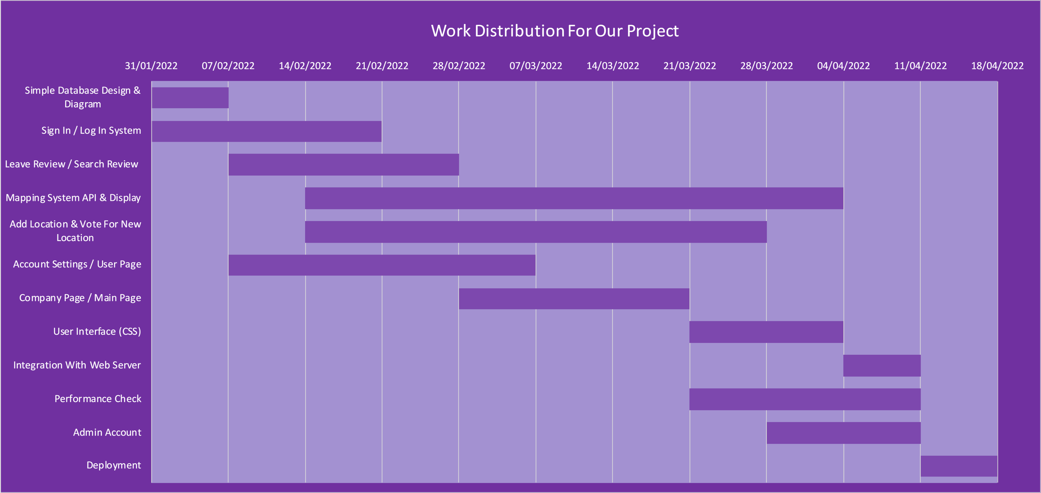
Team Organisation
A Gantt Chart Showing Work Distribution
Y18 | COMP10120 – First Year Team Project
19/21

Slide 20
Overview
Motivation – Why We Chose This Idea?
How Our Application Will Be Built?
Mock-up Designs
Security Features
Ethical Considerations
Team Organisation
Conclusion
Y18 | COMP10120 – First Year Team Project
20/21

Slide 21
Conclusion
Campus Compass is a web application made by students for students
Review, search and submit campus locations
Support new and existing students
Made with PHP, MySQL, CSS, HTML, JavaScript, Apache and GIT
Integrate interactive map using an external library.
Y18 | COMP10120 – First Year Team Project
21/21

